Slide 1


Physical examination
Pediatric Physical Assessment
Third Stage
Dr. Moustafa Ali Alshammari
Pediatric Nursing

Slide 2
Objectives
- Define physical examination
- Illustrate types of physical examination
- Explain preparation of the environment (examination room)
- Identify the sequence of pediatric physical examination

Slide 3
Definition
- Physical examination: Essential part of pediatric health assessment
- Requires strong physical assessment skills
- Knowledge of child development is critical
- Key techniques: Inspection, palpation, percussion, auscultation

Slide 4
Pediatric vs. Adult Examination
- Pediatric exam differs by age & developmental level
- Approach & sequence tailored to child’s stage
- Importance of comfort and cooperation (Chiocca, 2015)

Slide 5
Types of Physical Examination
- Complete (Head-to-Toe): New patients, annual visits, school/sports physicals
- Focused Examination: Based on chief complaint, performed during illness, injury, or emergency

Slide 6
Examination Techniques
- Inspection
- Palpation
- Percussion
- Auscultation
- Abdomen sequence: Inspection → Auscultation → Palpation → Percussion

Slide 7
Use of Senses in Exam
- Sight: color, respiratory effort, posture, gait
- Smell: hygiene, infections
- Touch: masses, skin changes
- Hearing: body sounds

Slide 8
Preparation of the Child
- Consider age & developmental level
- Build rapport: play with infants, conversation with older children
- Allow handling of equipment
- Example: Listening to parent’s heart with stethoscope

Slide 9
Preparation of the Environment
- Comfortable temperature, well lit, nonthreatening
- Age-appropriate decoration
- Keep instruments out of sight until needed
- Childproof environment
- Toys & reading material for distraction & assessment
- Ensure privacy at all ages

Slide 10
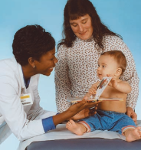

Sequence of Examination by Age
- Newborns (0–6 months): Supine, radiant warmer, diaper only, least distressing exam first
- Older Infants (6–12 months): Parent’s lap if anxious, stranger anxiety begins at 7–8 months

Slide 11

Toddlers
- Exam on parent’s lap or table
- Use play & distraction
- Stranger anxiety decreases ~18 months
- Often negativistic → Offer simple choices
- Praise cooperation

Slide 12

Preschoolers
- Exam table with parent nearby
- Use dolls/toys for demonstration
- Provide gown, remove clothes except underwear
- Concrete thinkers, magical thinking
- Protect modesty, careful with word choices

Slide 13
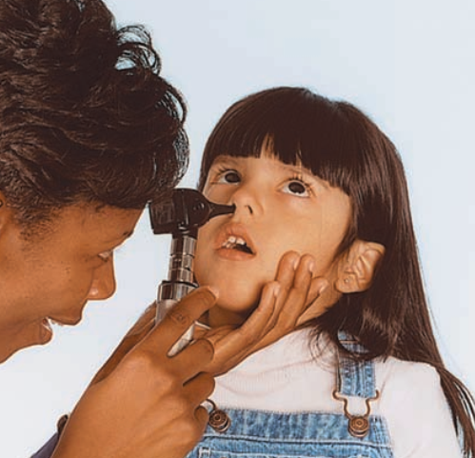
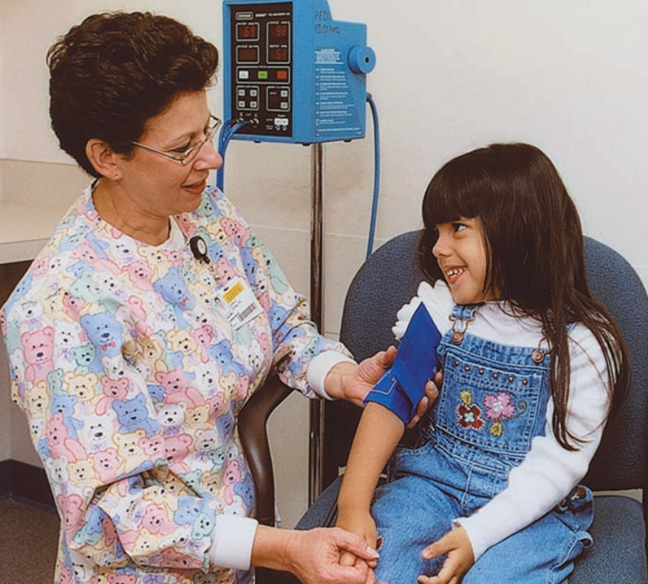
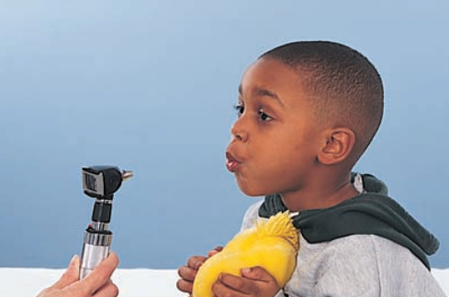
School-aged Children
- Exam table, provide gown
- Younger may prefer parent, older may prefer privacy
- Explain procedures, encourage participation
- See exam as fun/learning
- Head-to-toe with genitalia last

Slide 14
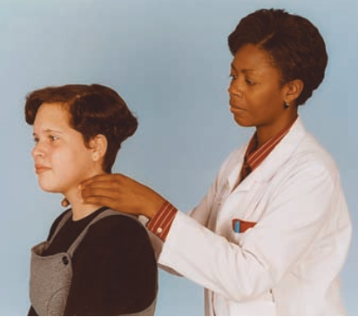
Adolescents
- Exam table, gown, undress in private
- Confidentiality is critical
- Offer choice of parent presence
- Address teen directly
- Head-to-toe with genitalia last
- Discuss sexuality, body development, emphasize normalcy

Slide 15
Physical Assessment of the Newborn (General Measurements)
- Head circumference: 33–35 cm (2–3 cm > chest)
- Chest circumference: 30.5–33 cm
- Crown-to-rump: 31–35 cm
- Head-to-heel: 48–53 cm
- Birth weight: 2700–4000 g

Slide 16
Newborn Vital Signs
- Temperature: 36.5–37 °C (Axillary)
- HR: 110–160 bpm (Apical)
- RR: 30–60 breaths/min
- BP: 65/41 mmHg

Slide 17
Newborn General Appearance
- Flexed posture (head & extremities)
- Skin: Puffy/smooth at birth, pink/flaky/dry by day 2–3
- Vernix caseosa, lanugo, acrocyanosis common

Slide 18
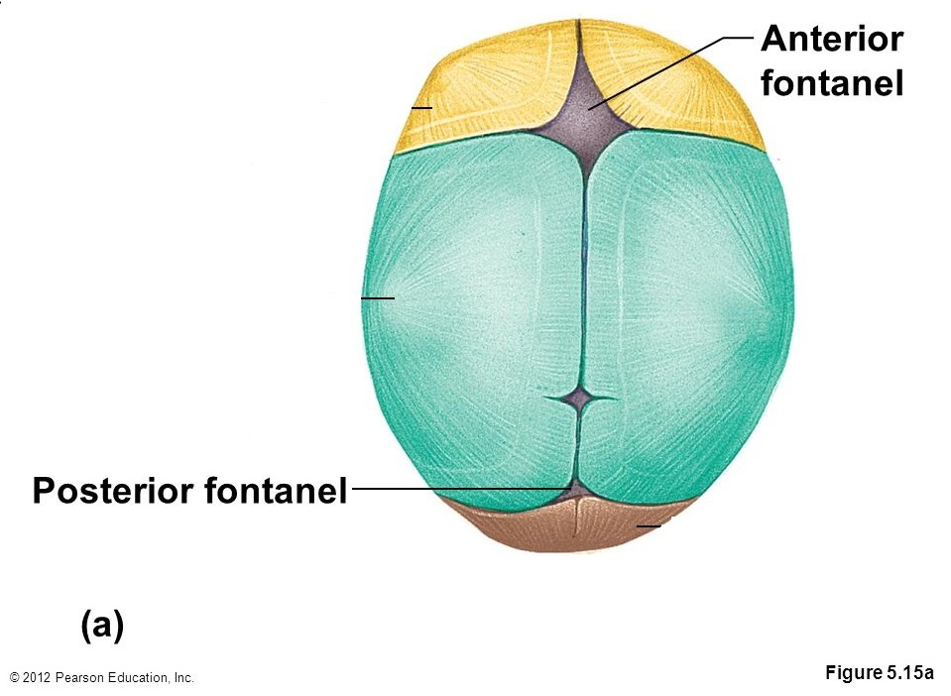
Head & Fontanels
- Anterior fontanel: Diamond-shaped (2.5–4 cm)
- Posterior fontanel: Triangular (0.5–1 cm)
- Should be flat & firm

Slide 19
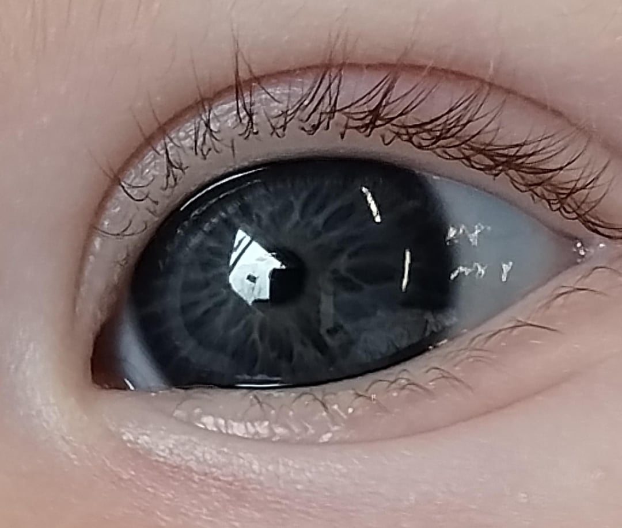
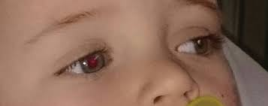
Newborn Eyes
a. Lids usually edematous
b. Iris color—slate gray, dark blue, brown; absence of tears
c. Presence of red reflex
d. Corneal reflex in response to touch
e. Pupillary reflex in response to light
f. Blink reflex in response to light or touch
g. Rudimentary fixation on objects and ability to follow to midline
Notes:
Finding Explanation a. Lids usually edematous Swelling of the eyelids is common in the first few days after birth due to pressure during delivery or eye ointment administration. b. Iris color—slate gray, dark blue, or brown; absence of tears Newborn iris color is often not permanent at birth; melanin develops over several months. Newborns do not produce tears until the lacrimal ducts mature (around 2–4 weeks of age). c. Presence of red reflex The red reflex is a bright reddish-orange reflection from the retina when a light is shone into the pupil (using an ophthalmoscope). It indicates a clear visual pathway. Absence may suggest cataracts or retinoblastoma. d. Corneal reflex (response to touch) The corneal reflex tests the infant’s protective mechanism — blinking in response to gentle touch on the cornea. e. Pupillary reflex (response to light) Shining a light into the eye should cause the pupil to constrict, showing an intact cranial nerve II (optic) and III (oculomotor). f. Blink reflex (response to light or touch) The newborn blinks when exposed to bright light or gentle touch. It is a protective reflex and part of normal neurological function. g. Rudimentary fixation on objects and ability to follow to midline Newborns can focus briefly on objects about 8–12 inches away (distance to caregiver’s face) and may follow movement to the midline.

Slide 20
Newborn Ears, Nose
. Position—Top of pinna on horizontal line with outer canthus of eye
b. Startle reflex elicited by a loud, sudden noise
c. Pinna flexible, cartilage present
Nose
a. Nasal patency
b. Nasal discharge—Thin, white mucus
c. Sneezing
d. Milia
Notes:
Finding Explanation a. Position—Top of pinna on horizontal line with outer canthus of eye The upper edge of the ear (pinna) should be at or above an imaginary line drawn from the outer corner of the eye (canthus). Low-set ears may be associated with chromosomal abnormalities (e.g., Down syndrome, renal anomalies). b. Startle reflex (Moro reflex) elicited by a loud, sudden noise When exposed to a loud sound, the newborn should startle, extend arms, and then flex them — this indicates normal auditory response and intact neurological function. c. Pinna flexible, cartilage present The pinna should feel soft but elastic; well-formed cartilage indicates term maturity. In preterm infants, ears may be soft and stay folded.
Finding Explanation a. Nasal patency Newborns are obligate nose breathers, meaning they breathe mainly through their nose. Both nostrils should be open. Blocked nares can cause respiratory distress during feeding. b. Nasal discharge—Thin, white mucus A small amount of clear or milky mucus is normal and helps clean the nasal passages. Thick, yellow, or green discharge may indicate infection. c. Sneezing Sneezing in newborns is normal and helps clear nasal passages of mucus or amniotic fluid. It is not a sign of a cold in the first few days. d. Milia Milia are tiny white papules (sebaceous cysts) seen on the nose and cheeks due to blocked sebaceous glands. They are harmless and disappear within weeks.

Slide 21
Nose, Mouth & Throat
- Mouth: a. Intact, high-arched palate
b. Uvula in midline
c. Frenulum of tongue
d. Frenulum of upper lip
e. Sucking reflex—Strong and coordinated
f. Rooting reflex
g. Gag reflex
i. Absent or minimal salivation
j. Vigorous cry
Notes:
Finding Explanation a. Intact, high-arched palate The palate (roof of the mouth) should be intact without clefts or openings. A slightly high arch is normal. A cleft palate can interfere with feeding and increase aspiration risk. b. Uvula in midline The uvula should hang centrally. A deviated or bifid uvula may suggest submucous cleft palate. c. Frenulum of tongue (lingual frenulum) The frenulum connects the tongue to the floor of the mouth. If it is too short (“tongue-tie” or ankyloglossia), it can affect breastfeeding and speech later. d. Frenulum of upper lip The upper labial frenulum connects the inner upper lip to the gum. A prominent frenulum is common and usually benign, unless it interferes with feeding or dental eruption later. e. Sucking reflex—Strong and coordinated The newborn should demonstrate a rhythmic sucking pattern, which indicates intact cranial nerves V, VII, IX, and XII and feeding readiness. f. Rooting reflex When the baby’s cheek or lip is stroked, the infant turns toward the stimulus and opens the mouth—helps locate the breast/nipple. g. Gag reflex Touching the back of the throat elicits a gagging or coughing response, protecting from aspiration. h. Absent or minimal salivation In newborns, salivary glands are immature, so drooling is minimal. Excessive drooling may indicate esophageal atresia or tracheoesophageal fistula. i. Vigorous cry A strong, lusty cry indicates good respiratory effort and neurologic health. A weak, high-pitched, or hoarse cry can signal neurological damage, prematurity, or laryngeal problems.

Slide 22
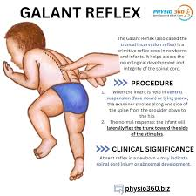
Neck, Chest, Back, Rectum
- Neck: Short, thick, tonic neck reflex
- Chest:
a. Anteroposterior and lateral diameters equal
b. Slight sternal retractions evident during inspiration
c. Xiphoid process evident
d. Breast enlargement
- Back: a. Spine intact; no openings, masses, or prominent curves, b. Trunk incurvation reflex (Galant reflex), c. Anal reflexd. Patent anal opening, Passage of meconium within 48 hours
Notes:
Neck: Short, thick, tonic neck reflex
The newborn neck appears short and thick due to undeveloped neck muscles and fat pads. The tonic neck reflex (fencing position) is elicited when the infant’s head is turned to one side; the arm and leg on that side extend, while the opposite side flexes — showing normal neuromuscular tone.
Finding Explanation a. Anteroposterior and lateral diameters equal The chest of a newborn is nearly circular, meaning the front-to-back (AP) and side-to-side (lateral) diameters are approximately the same. This is a normal chest shape in infancy. b. Slight sternal retractions evident during inspiration Mild inward movement of the sternum during inspiration may occur due to the soft chest wall of neonates. Marked or persistent retractions indicate respiratory distress. c. Xiphoid process evident The xiphoid process (bottom tip of the sternum) may protrude slightly and is visible or palpable — a normal finding in newborns due to thin chest wall. d. Breast enlargement Temporary breast swelling may occur in both sexes due to maternal hormones (estrogen) crossing the placenta. Occasionally, a small amount of milky secretion (“witch’s milk”) may appear.
Finding Explanation a. Spine intact; no openings, masses, or prominent curves The spinal column should be straight and continuous without dimples, tufts of hair, or open areas. Any defect may indicate spina bifida or meningocele. b. Trunk incurvation reflex (Galant reflex) When one side of the newborn’s back is stroked, the trunk curves toward that side. This indicates a normal spinal cord and peripheral nerve function. c. Anal reflex Touching or lightly scratching the anal area causes constriction (wink reflex) — a sign of intact sacral spinal nerves. d. Patent anal opening The anus should be present and open. Absence or abnormal placement indicates imperforate anus, a surgical emergency. e. Passage of meconium within 48 hours Newborns usually pass meconium (black, tarry stool) within the first 24–48 hours. Delayed passage may indicate intestinal obstruction or Hirschsprung’s disease.

Slide 23
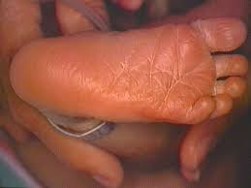
Extremities
a. Ten fingers and ten toes
b. Full range of motion
c. Nail beds pink, with transient cyanosis immediately after birth
d. Creases on anterior two thirds of sole
e. Sole usually flat
f. Symmetry of extremities
g. Equal muscle tone bilaterally, especially resistance to opposing flexion
h. Equal bilateral brachial and femoral pulses

Slide 24
Neuromuscular System
a. Extremities usually maintain some degree of flexion.
b. Extension of an extremity followed by previous position of flexion
c. Head lag while sitting, but momentary ability to hold head erect
d. Able to turn head from side to side when prone
e. Able to hold head in horizontal line with back when held prone
Notes:
Finding Explanation a. Extremities usually maintain some degree of flexion Normal newborn posture is characterized by flexed arms and legs, reflecting good muscle tone and neurological maturity. Flaccid posture or extended limbs may indicate prematurity or CNS depression. b. Extension of an extremity followed by previous position of flexion When an extremity is gently extended, it should return to the flexed position—a sign of normal muscle tone and reflex activity. c. Head lag while sitting, but momentary ability to hold head erect When pulled from lying to sitting, the newborn’s head lags behind because neck muscles are weak. Brief head control indicates normal neuromuscular development for age. d. Able to turn head from side to side when prone When placed on the abdomen, the newborn can lift the head slightly and turn it to either side, demonstrating early neck muscle strength and airway protection. e. Able to hold head in horizontal line with back when held prone When the newborn is held in a prone (ventral suspension) position, the head should align in a straight line with the spine due to developing muscle tone.

Slide 25
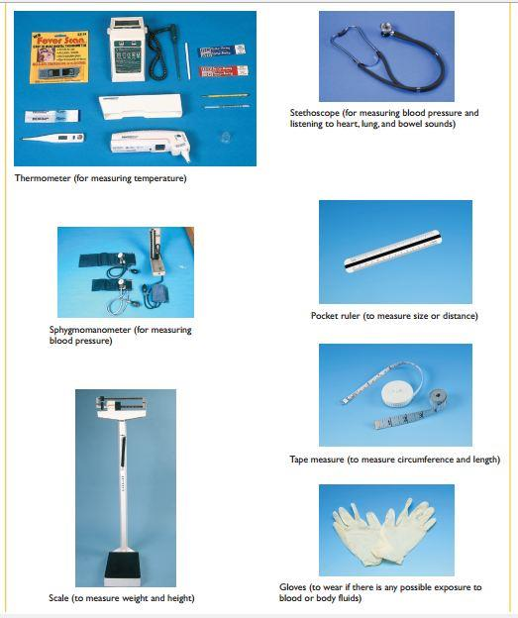
Equipment of physical assessment

Slide 26
Thank you

